Slide 1
Flatpickr Custom Element

Slide 2
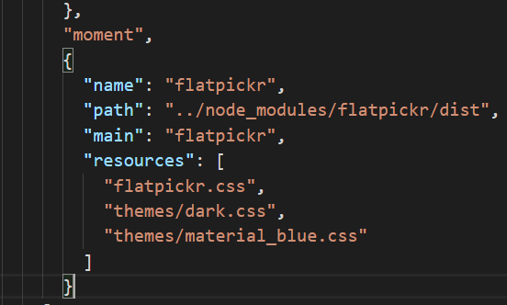
flatpickr
https://chmln.github.io/flatpickr/
npm install flatpickr
Add this to aurelia.json
,
{
"name": "flatpickr",
"path": "../node_modules/flatpickr/dist",
"main": "flatpickr",
"resources": [
"flatpickr.css",
"themes/dark.css",
"themes/material_blue.css"
]
}

Slide 3
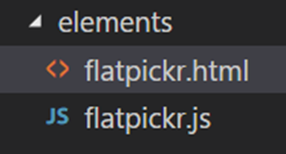
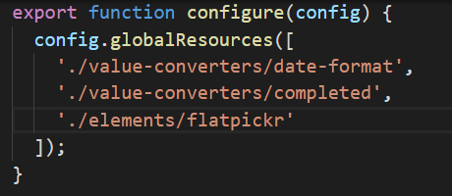
Create a Custom Element
A custom element is a self-contained component that can be used throughout and application. In this case we will create a date picker control based on the popular flatpickr date picker control.
Create the following files in the resources/elements folder
Update the resources/index.js file

Slide 4
flatpickr.html
<template>
<require from="flatpickr/flatpickr.css"></require>
<div class="input-group aurelia-flatpickr">
<input type="text" class="aurelia-flatpickr form-control flatPicker" data-input>
</div>
</template>

Slide 5
flatpickr.js
import {inject, bindable, bindingMode} from 'aurelia-framework';
import Flatpickr from 'flatpickr';
@inject(Element)
export class FlatPickerCustomElement {
@bindable({defaultBindingMode: bindingMode.twoWay}) value;
constructor(element) {
this.element = element;
}
…
@bindable makes the value variable bindable using a value.bind construction
this.element = element creates a reference to the custom element

Slide 6
The bind() method runs when the data is bound to the HTML
Create a configuration object: altInput tells flatpickr to show the date according to the altFormat format, wrap indicates the control is enclosed in an input group
…
bind() {
const defaultConfig = {
altInput: true,
altFormat: "F j, Y",
wrap: true
};
this._config = Object.assign({}, defaultConfig);
this._config.onChange = this._config.onMonthChange = this._config.onYearChange = this.onChange.bind(this);
}
…
The first line configures flatpickr with the config object and the second line configures flatpickr with an event handler for when the date changes.

Slide 7
The attach method runs when the HTML has been created. First create a flatpickr instances and then run the valueChanged() function to set the initial date.
…
attached() {
this.flatpickr = new Flatpickr(this.element.querySelector('.aurelia-flatpickr'), this._config);
}
onChange(selectedDates, dateStr, instance) {
this.value = selectedDates[0]
}
…
The onChange event handler sets the value variable to the selected date. Dates returned from a date input control are in an array. We just select the first date.

Slide 8
…
valueChanged() {
if (!this.flatpickr) {
return;
}
if (this.value === this.flatpickr.selectedDates[0]){
return;
}
let newDate = this.value ? this.value : undefined;
this.flatpickr.setDate(newDate);
}
}
valueChanged() runs any time the value variable changes.
Make sure the flatpickr instance exists
Check to see if the date in the custom element (value) is the same as the date
in the flatpickr instance.
Set the flatpickr date to the new value or undefined

Slide 9
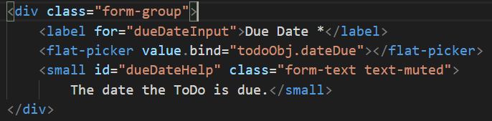
Replace the data picket in todoForm.html

